Slide 1
Cash Flow Analysis
Dr. Manish Dadhich

Slide 2
Meaning
Cash: Cash means all cash + cash equitable + marketable securities + bank balance .
Flow: Flow means flow of cash from business to economy and economy to business i.e. cash inflows and cash outflows.
Statement : Statement is a performa prescribed by Charted Accountant Act,1948.
Thus,
Cash Flow Statement is a statement o f inflows (sources) and outflows (uses) of cash and cash equivalents in an enterprise during a specified period of time.

Slide 3
Introduction
Cash plays a very important role in the economic life of a business.
A firm needs cash to make payment to its suppliers, to incur day-to-day expenses and to pay salaries, wages, interest and dividends etc.Thus, it is very essential for a business to maintain an adequate balance of cash.
For example, a concern operates profitably but it does not have sufficient cash balance to pay dividends, what message does it convey to the shareholders and public in general.
Thus, management of cash is very essential.
•
•
•
•
•

Slide 4
Cash flow statement
Cash flow statement provides information about the cash
receipts (Inflows) and payments (outflows) of a firm for a given period.
It is a statement depicting change in cash position from one period to another.
For example, if the cash balance of business is shown by its Balance sheet on 31st December, 2012 at $20,000 while the cash balance as per its balance sheet on 31st December, 2013 is $ 30,000. There has been an inflow of cash of $10,000 in the year 2013 as compared to the year 2012.
It explains the reasons for such inflows or outflows of cash, as the case may be.
It also helps management in making plans for the immediate future.
•
•
•
•

Slide 5
Purpose of the Statement
♣
To provide relevant information about the cash receipts and cash payments of an enterprise during a period.
The statement provide answers to the following questions:
1. Where did the cash come from?
♣
What was the cash used for?
What was the change in the cash balance?

Slide 6
Why cash flow Analysis ???
Its an important analytical tool for creditors, investors and other users of financial statement data.
Firm’s ability to generate cash flows in the future
Firm’s capacity to meet cash obligations
Firm’s future external financing needs
Firm’s success in productively managing investing activities
Firm’s effectiveness in implementing financing and investing strategies

Slide 7
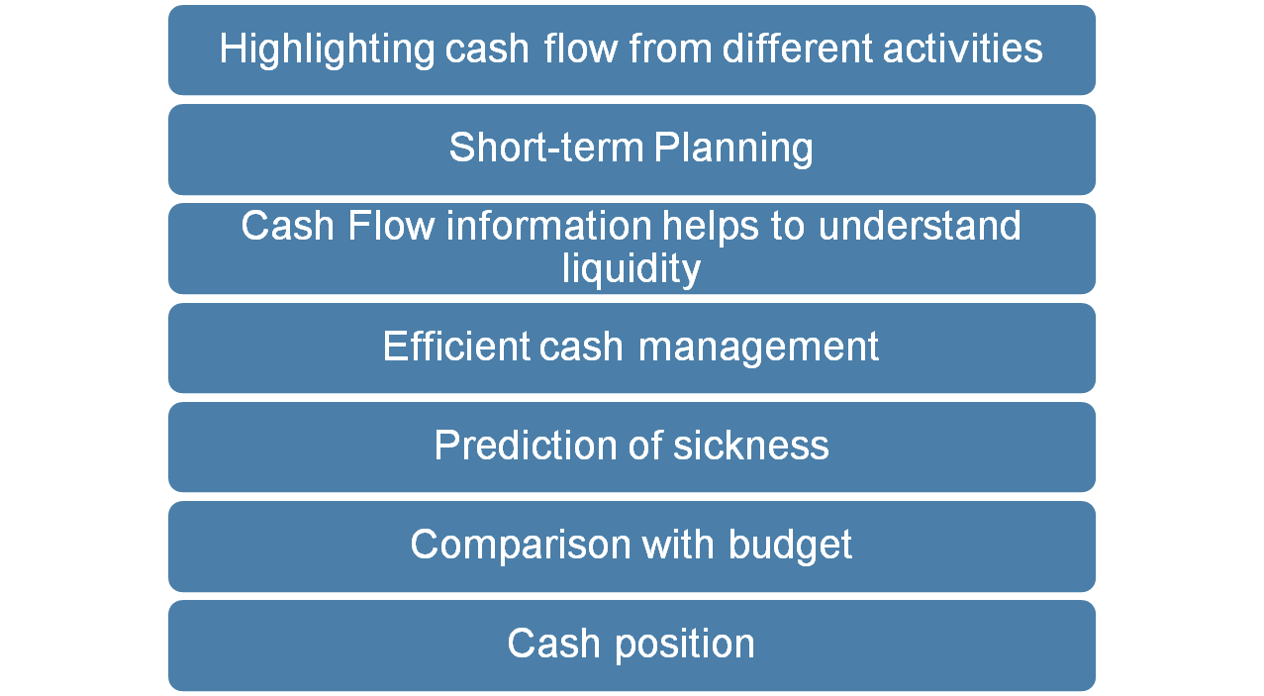
Objectives of Cash Flow Statement

Slide 8
Cash Flow Statement : Limitations
•
Does not show the liquidity position of the firm because an income statement takes into account both cash as well as non-cash items
•
It is not a substitute of income statement
•
Does not show the financial position of the firm in totality

Slide 9
Difference b/w Cash Flow & Fund flow
Cash Flow Statement
Meaning of fund: Cash means only cash which is a component of net current assets.
Objective: Its objective is to know about the changes occurred in cash position between two balance sheet dates.
Basis of preparation: Increase in current liability or decrease in current asset (except cash) results in an
Fund Flow Statement
Fund means net working capital (i.e. current assets minus current liabilities).
Its objective is to know about the changes occurred in net working capital between two balance dates.
Increase in current liability and decrease in current asset results in a decrease in net working

Slide 10
Continued….
Effect of transaction: Effect of a transaction on cash is considered.
Utility: Cash flow statement is useful for short-term analysis.
Statement of changes in Working Capital: No such statement is prepared separately in cash flow statement.
Cash Balances: Opening and closing balances of cash
Effect of a transaction on net working capital is considered.
Fund flow statement is useful for long-term analysis.
A separate statement for changes in working capital is prepared in fund flow statement or analysis.
Such balances of cash are shown in statement of

Slide 11
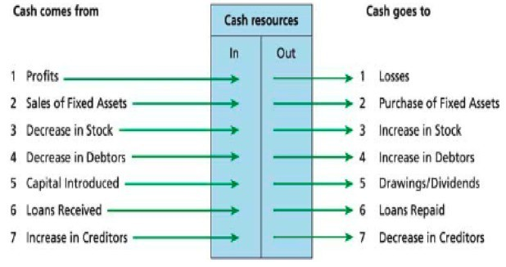
Where from: Where to?

Slide 12
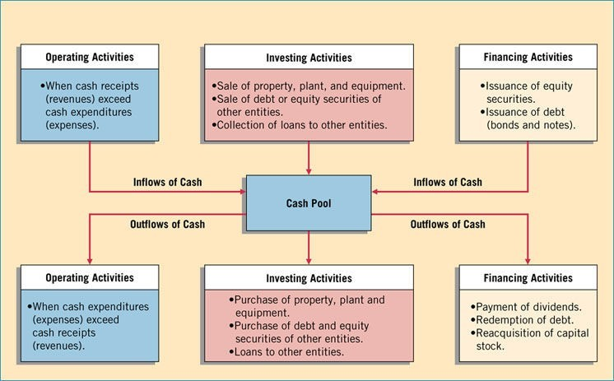
Classification of
Cash Inflows and Outflows

Slide 13
Operating activities
It includes receiving cash from customers for the sale of goods and services, receiving interest and dividends on loans and investments, and making cash payments for wages, goods and services purchased, interest, and taxes.
Operating Activities
Cash Inflow
Cash Outflow
Cash Purchases
Payment to Creditors
Cash Operating Expenses
Payment of Wages
Income Tax
Manufacturing Expenses
Cash Sales
Received from Debtor
Commission & Fees
Royalty
Cash effects the transaction on Net Income

Slide 14
Classification
As per Accounting Standard-3 (revised) the changes resulting in cash inflows and cash outflows arise on account of three types of activities –
Cash Flow form Operating Activities:
Operating activities are the principle revenue producing activities of the enterprise and other activities that are not investing and financing activities. Hence, these are the results of those transactions and events that determines the net profit or loss.

Slide 15
Continued….
Examples are:
Cash receipts from the sale of goods and the rendering of services
Cash receipts from royalties, fees, commissions and other revenues
Cash payments to suppliers of goods and services
Cash payments to and on behalf of employees
Cash receipts and cash payments of an insurance enterprise for premiums and claims, annuities and other policy benefits
Cash payments or refunds of income taxes unless they can be specifically identified with financing and investing activities

Slide 16
Investing activities
It includes purchasing and selling long-term assets and marketable securities (other than cash equivalents), as well as making and collecting on loans.
Investing Activities
Cash Inflow
Cash Outflow
Purchase of Fixed Assets
Purchase of Investments
Working Capital
Sale of Fixed Assets
Sale of investments
Interest Received
Dividend Received
Working Capital Recovery

Slide 17
Continued….
Cash Flow from Investing Activities:
Investing activities include the acquisition and disposal of long-term assets and other investments not included in cash equivalents. The separate disclosure of cash flows arising from investing activities is important.
Examples are:
Cash payments to acquire fixed assets (including intangibles)
Cash receipts from disposal of fixed assets (including intangibles)

Slide 18
Continued….
Cash payments to acquire and cash receipts from disposal of shares, warrants or debt instruments of other enterprises and interests in joint ventures.
Cash advances and loans made to 3rd parties
Cash payments and receipts for future contracts, forward contracts, option contracts and swap contracts except when the contracts are held for dealing or trading purposes, or the payments are classified as financing activities

Slide 19
Financing activities
It includes issuing and buying back capital stock, as well as borrowing and repaying loans on a short- or long-term basis (issuing bonds and notes). Dividends paid are also included in this category.
Financing Activities
Cash Inflow
Cash Outflow
Payment of Loans
Redemption of Preference Shares
Payment of Dividends
Interest Paid
Repayment of Finance/ Lease Liability
Issue of Shares in Cash
Issue of Debentures in Cash
Proceeds from long-term borrowings

Slide 20
Continued….
Cash Flow from Financing Activities:
The separate disclosure of cash flows arising from financing activities is important because it is useful in predicting claims of future cash flows by providers of funds (both capital and loan)to the enterprise. Financing activities are activities that result in changes in the size and composition of the owners capital (including preference share capital in the case of a company) and borrowings of the enterprise.

Slide 21
Continued….
Examples are:
Cash proceeds from issuing shares or other similar instruments
Cash proceeds from issuing debentures, loans, notes, bonds and other short or long term borrowings, and
Cash repayments of amounts borrowed such as redemption of dentures, bonds, preference shares.

Slide 22
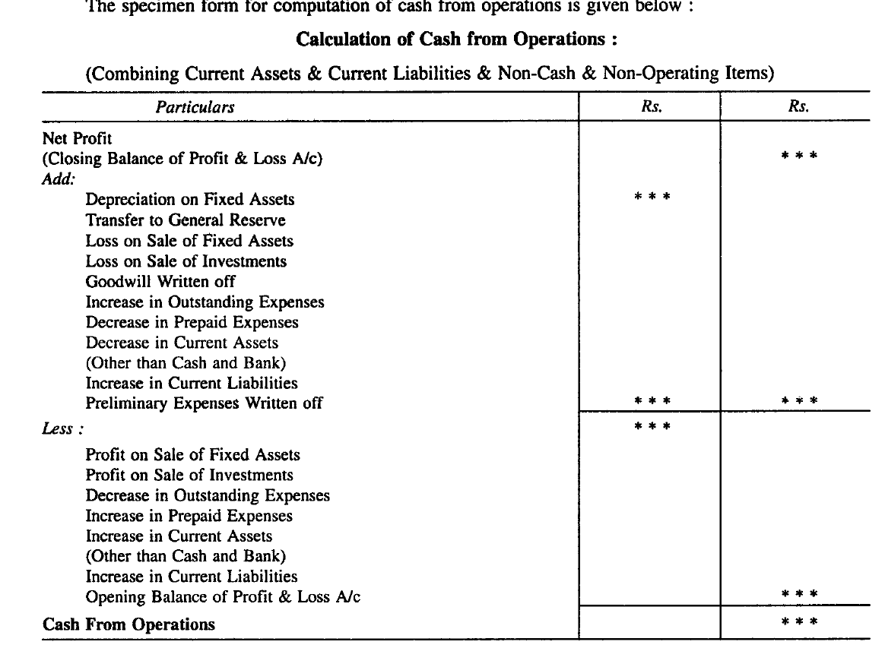

Slide 23
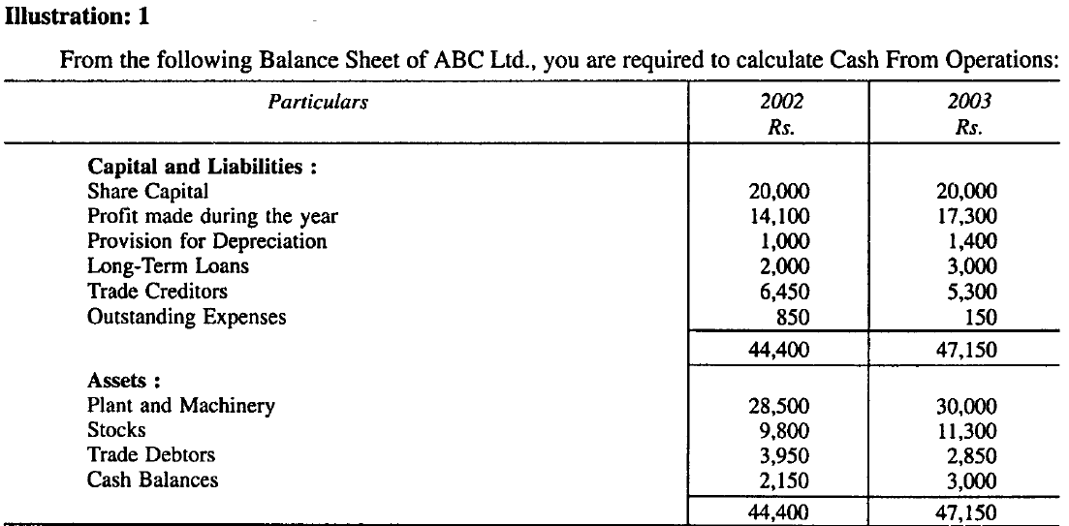

Slide 24
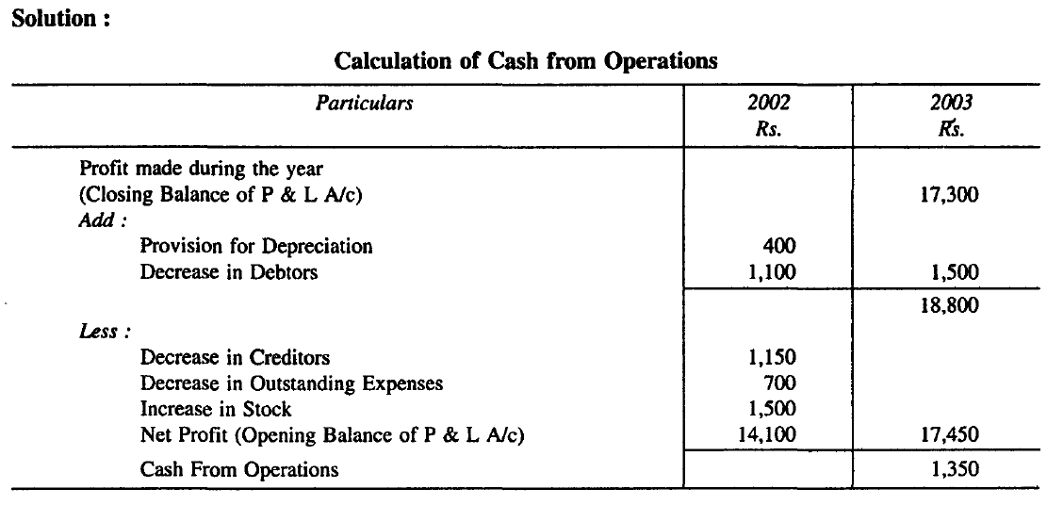

Slide 25
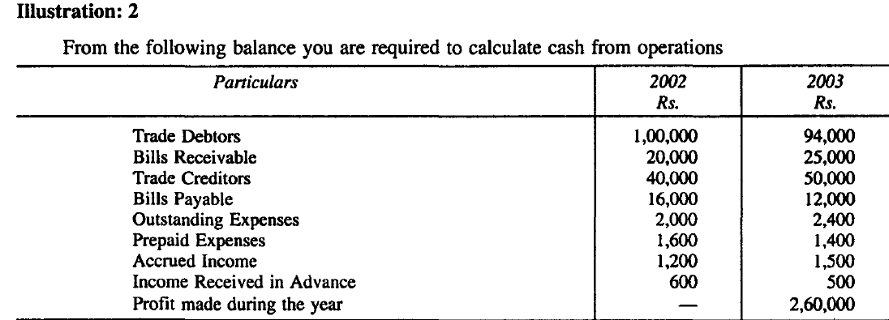

Slide 26
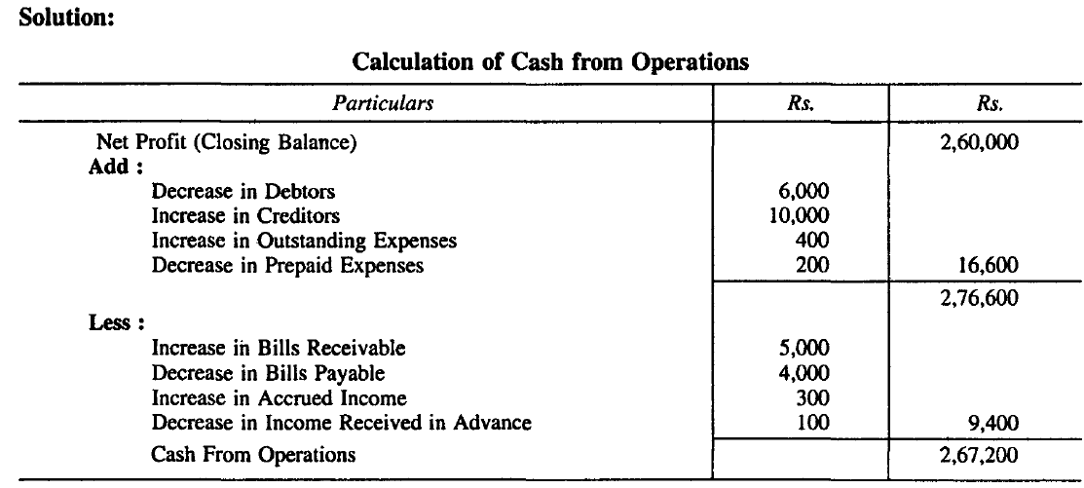

Slide 27
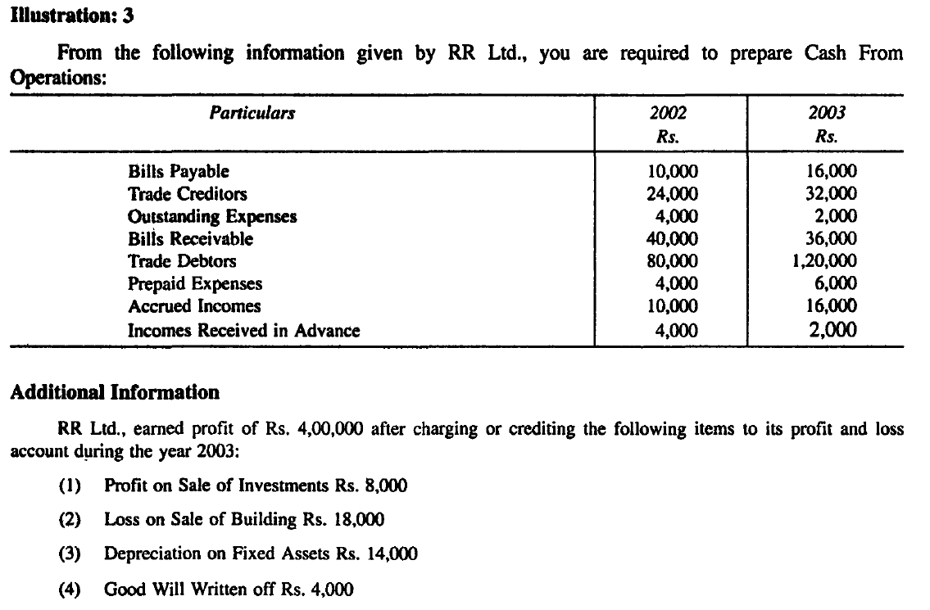

Slide 28
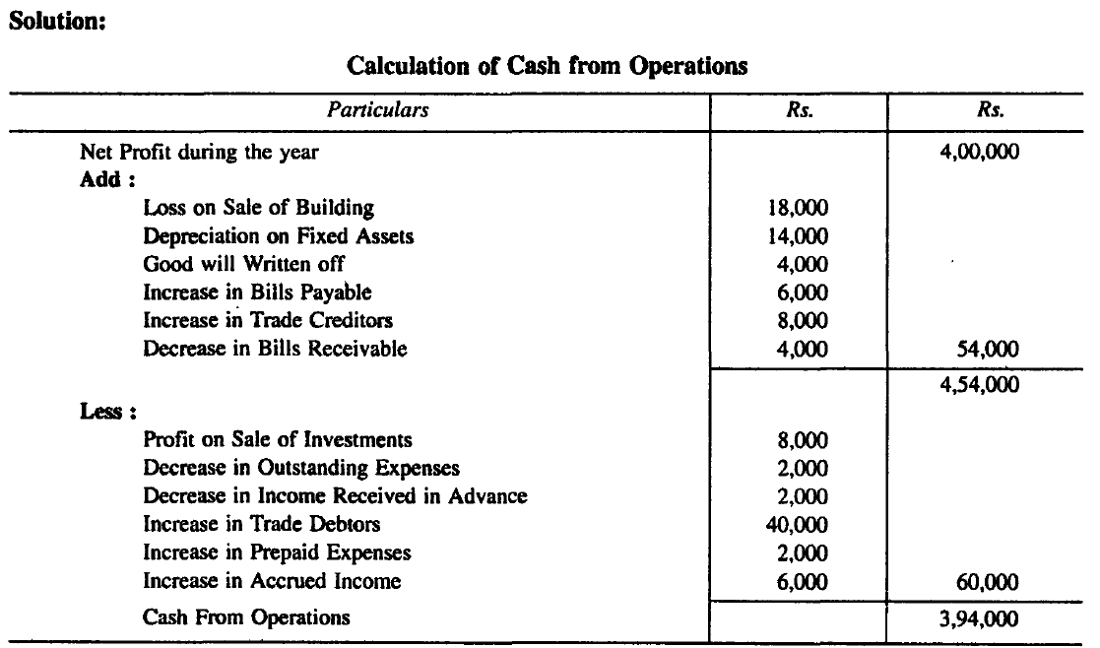

Slide 29
Thank You

